Slide 1
Drugs used in thyroid disorders

Slide 2
Treatment of thyroid disorders
Thyroid hormone physiology
Treatment of hypothyroidism
Treatment of hyperthyroidism

Slide 3
Thyroid hormone physiology
2 naturally occurring active forms
T3 ---tri-iodo-L-thyronine
T4 ---- tetra-iodo-L-thyronine
T4 is a prohormone with very little intrinsic activity.
It is deiodinated in peripheral tissues to form T3, the active thyroid hormone

Slide 4
Thyroxin therapy
Treating hypothyroidism
Management of thyroid carcinoma

Slide 5
Thyroxin preparations
Levothyroxine (T4)
Drug of choice to treat hypothyroidism
Increases basal metabolic rate
Increases utilization and mobilization of glycogen stores
Promotes gluconeogenesis
Stimulates protein synthesis
-

Slide 6
Levothyroxine (T4)
Absorption
40-80% from GI tract (PO)
Bioavailability: 60% (nonfasting); 80% (fasting)
T1/2 -7d in euthyroid
Distribution
Protein bound: 99%
Vd: 9-10 L

Slide 7
Liothyronine(T3)
More potent than T4.
T1/2 - 2 days
Rapid onset of action-can induce heart failure-so not routinely used

Slide 8
Treatment of hypothyroidism
Recommended Levothyroxine dosage -1.6 μg/kg per day in adults
Lower initial dose in ,
-elderly
-those with cardiac disease

Slide 9
Treatment of hypothyroidism..
Taken on an empty stomach upon waking in the morning
spaced out from meals, tea, coffee, by at least ½-1 hour duration.

Slide 10
Treatment of hypothyroidism-monitoring
Evaluate clinically and with TFT 6-8 weekly till FT4 and TSH are normalized.
Once the thyroid functions have normalized, patient can be reviewed every 6 to 12 months.
Avoid overtreatment -----Osteoporosis /atrial fibrillation may result

Slide 11
Causes of failure to normalize TSH during treatment
• Non compliance
• Factors affecting absorption
-Taking levothyroxine close to a meal
-Drug interfering in absorption e.g. cholestyramine, ferrous sulfate
-malabsorption

Slide 12
Causes of failure to normalize TSH during treatment..
• Drugs accelerating metabolism
e.g. phenytoin, carbamazepine
• Bioequivalence of different levothyroxine preparations may differ.

Slide 13
Hypothyroidism in pregnancy
Untreated hypothyroidism during pregnancy -increase the incidence of maternal and fetal complications including impairment of fetal cognitive development.
Increase the dose of levothyroxine as soon as pregnancy is confirmed
Monitor TFT frequently and adjust dose
Screen neonate for hypothyroidism

Slide 14
Subclinical Hypothyroidism
READ..!

Slide 15
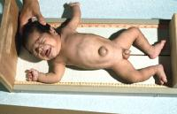
Congenital hypothyroidism in children
READ..!

Slide 16
READ..!
In central hypothyroidism replace cortisol deficiency prior to starting levothyroxin

Slide 17
Thyroxin in thyroid CA management
In thyroid carcinoma patients, aim of levothyroxine therapy is to achieve appropriate TSH suppression.

Slide 18
Treatment of hypothyroid coma
READ..!

Slide 19
Treatment of hyperthyroidism

Slide 20
Treatment of hyperthyroidism
Symptomatic treatment –Beta blockers eg:propranolol -- withdraw once euthytoid
Definite treatment
-antithyroid drugs
-radioiodine
-surgery

Slide 21
Antithyroid drugs
preferred first line treatment for Grave’s disease and until definitive treatment for toxic multinodular goiter and toxic adenoma.

Slide 22
Antithyroid drugs
Carbimazole/ methimazole
Propylthiouracil

Slide 23
Antithyriod drugs –mechanism of action
inhibit thyroid hormone synthesis by interfering with thyroid peroxidase mediated iodination of tyrosine residues in thyroglobulin, an important step in the synthesis of thyroxine and triiodothyronin

Slide 24
Propylthiouracil can also block the conversion of T4 to T3.
antithyroid drugs may have clinically important immunosuppressive effects

Slide 25
Antithyroid drugs
relatively simple molecules
Actively concentrated by the thyroid gland

Slide 26
Adverse effects
Minor
urticaria and other rashes
arthralgia
gastrointestinal upset
Major
Agranulocytosis
Hepatotoxicity
Vasculitis

Slide 27
Antithyroid drugs
Start treatment at high dose and titrate to a lower dose
Duration of Tx- 12-18 months
Monitoring treatment
-FT4/TSH
-Baseline FBC and liver profile.

Slide 28
Patient education to seek medical advice urgently in the presence of side effects (pruritic rash, jaundice, pharyngitis, fever) with urgent FBC and liver functions is mandatory.

Slide 29
Antithyorid drugs in pregnancy and lactation
Both carbimazole and PTU are NOT considered 100% safe –but PTU preferred in pregnancy as carbimazole causes fetal malformations (aplasia cutis)
Both are safe in lactation

Slide 30
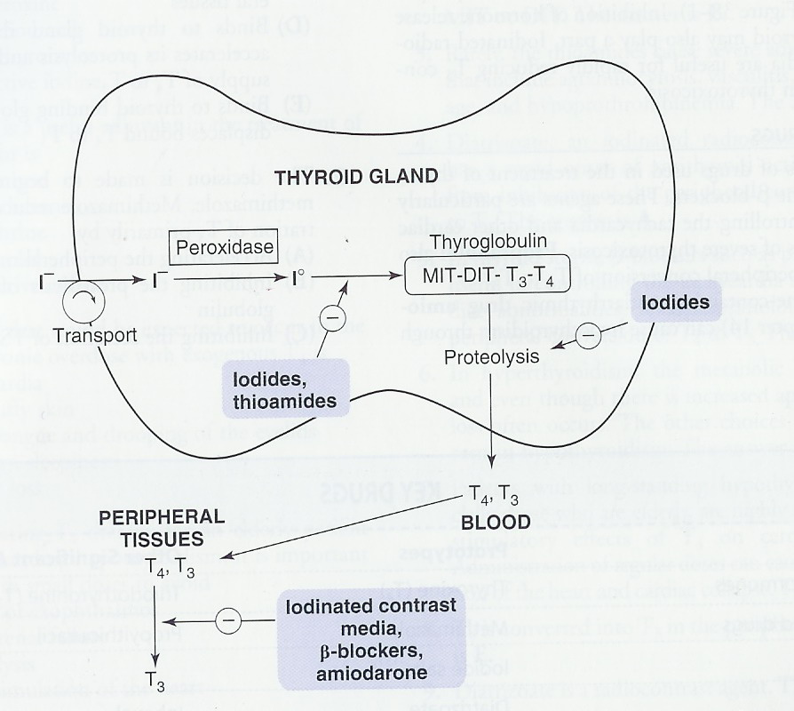

Slide 31
Iodides (NaI, KI)
Pharmacological action
Inhibition of T3 & T4 release and synthesis
Decrease of size & vascularity of the hyperplastic gland
Indications
1.Hyterthyroidism
2. Thyroid crisis.
3. Before Sx

Slide 32
Thyroid storm –management
• Thermal regulation
• Treatment of arrhythmias
• Treatment of precipitating cause eg. -. antibiotics
• Propylthiouracil (to block thyroid hormone synthesis and T4 to T3 conversion)
• Potassium iodide therapy (Lugol solution) -to inhibit thyroid hormone release
• Beta blockers
• Intravenous hydrocortisone 100mg 6 hourly (to inhibit T4 to T3 conversion)

Slide 33
THANK YOU

